Slide 1
CCNA Security
Chapter Three
Authentication, Authorization, and Accounting

Slide 2
Lesson Planning
This lesson should take 3-6 hours to present
The lesson should include lecture, demonstrations, discussion and assessment
The lesson can be taught in person or using remote instruction

Slide 3
Major Concepts
Local Authentication
Enhancements to Local Authentication
Describe the purpose of AAA and the various implementation techniques
Implement AAA using the local database
Implement AAA using TACACS+ and RADIUS protocols
Implement AAA Authorization and Accounting

Slide 4
Lesson Objectives
Upon completion of this lesson, the successful participant will be able to:
Describe the importance of AAA as it relates to authentication, authorization, and accounting
Configure AAA authentication using a local database
Configure AAA using a local database in SDM
Troubleshoot AAA using a local database
Explain server-based AAA
Describe and compare the TACACS+ and RADIUS protocols

Slide 5
Lesson Objectives
Describe the Cisco Secure ACS for Windows software
Describe how to configure Cisco Secure ACS for Windows as a TACACS+ server
Configure server-based AAA authentication on Cisco Routers using CLI
Configure server-based AAA authentication on Cisco Routers using SDM
Troubleshoot server-based AAA authentication using Cisco Secure ACS
Configure server-based AAA Authorization using Cisco Secure ACS
Configure server-based AAA Accounting using Cisco Secure ACS
Notes:
5

Slide 6
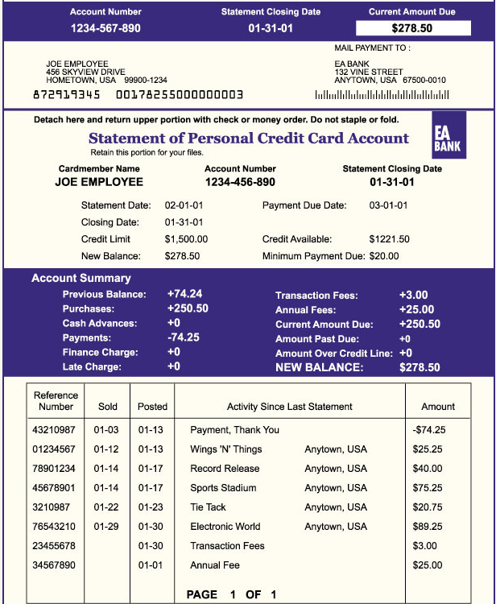

AAA Access Security
Authorization
which resources the user is allowed to access and which
operations the user is allowed to perform?
Authentication
Who are you?
Accounting
What did you spend it on?

Slide 7


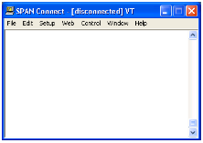
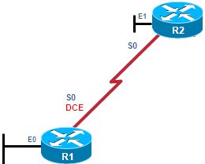
Authentication – Password-Only
Password-Only Method
User Access Verification
Password: cisco
Password: cisco1
Password: cisco12
% Bad passwords
Internet
R1(config)# line vty 0 4
R1(config-line)# password cisco
R1(config-line)# login
Uses a login and password combination on access lines
Easiest to implement, but most unsecure method
Vulnerable to brute-force attacks
Provides no accountability

Slide 8


Authentication – Local Database
Creates individual user account/password on each device
Provides accountability
User accounts must be configured locally on each device
Provides no fallback authentication method
R1(config)# username Admin secret Str0ng5rPa55w0rd
R1(config)# line vty 0 4
R1(config-line)# login local
User Access Verification
Username: Admin
Password: cisco1
% Login invalid
Username: Admin
Password: cisco12
% Login invalid
Internet
Local Database Method

Slide 9






Local Versus Remote Access
Local Access
Remote Access
LAN 2
R1
Firewall
R1
R2
LAN 1
Internet
Internet
LAN 3
Console Port
Administrator
Requires a direct connection to a console port using a computer running terminal emulation software
Management LAN
Administration Host
Logging Host
Uses Telnet, SSH HTTP or SNMP connections to the router from a computer
Notes:
9

Slide 10
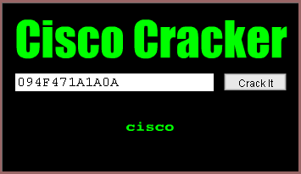
Password Security
To increase the security of passwords, use additional configuration parameters:
Minimum password lengths should be enforced
Unattended connections should be disabled
All passwords in the configuration file should be encrypted
R1(config)# service password-encryption
R1(config)# exit
R1# show running-config line con 0 exec-timeout 3 30
password 7 094F471A1A0A login
line aux 0 exec-timeout 3 30
password 7 094F471A1A0A
login
Notes:
10

Slide 11
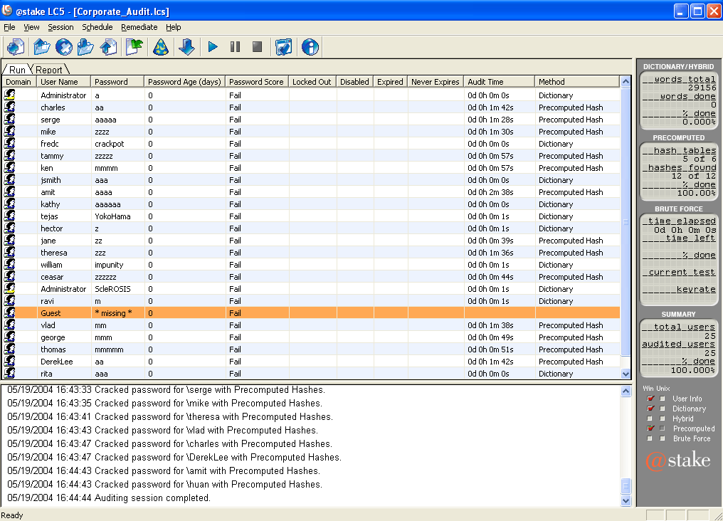
Passwords
An acceptable password length is 10 or more characters
Complex passwords include a mix
of upper and lowercase letters,
numbers, symbols and spaces
Avoid any password based on repetition, dictionary words, letter or number sequences, usernames, relative or pet names, or biographical information
Deliberately misspell a password (Security = 5ecur1ty)
Change passwords often
Do not write passwords down and leave them in obvious places
Notes:
11

Slide 12
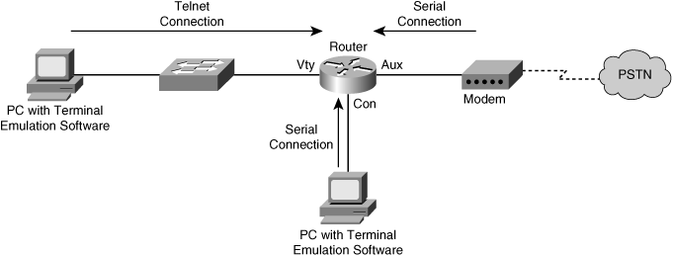
Access Port Passwords
Command to restrict access to privileged EXEC mode
R1(config)# enable secret cisco
Commands to establish a login password on incoming Telnet sessions
Commands to establish a login password for dial-up modem connections
R1(config)# line vty 0 4
R1(config-line)# password cisco
R1(config-line)# login
R1(config)# line aux 0
R1(config-line)# password cisco
R1(config-line)# login
R1
R1(config)# line con 0
R1(config-line)# password cisco
R1(config-line)# login
Commands to establish a login password on the console line
Notes:
12

Slide 13
Creating Users
username name secret {[0]password|5encrypted-secret}
Parameter | Description
name | This parameter specifies the username.
0 | (Optional) This option indicates that the plaintext password is to be hashed by the router using MD5.
password | This parameter is the plaintext password to be hashed using MD5.
5 | This parameter indicates that the encrypted-secret password was hashed using MD5.
encrypted-secret | This parameter is the MD5 encrypted-secret password that is stored as the encrypted user password.
Notes:
13

Slide 14
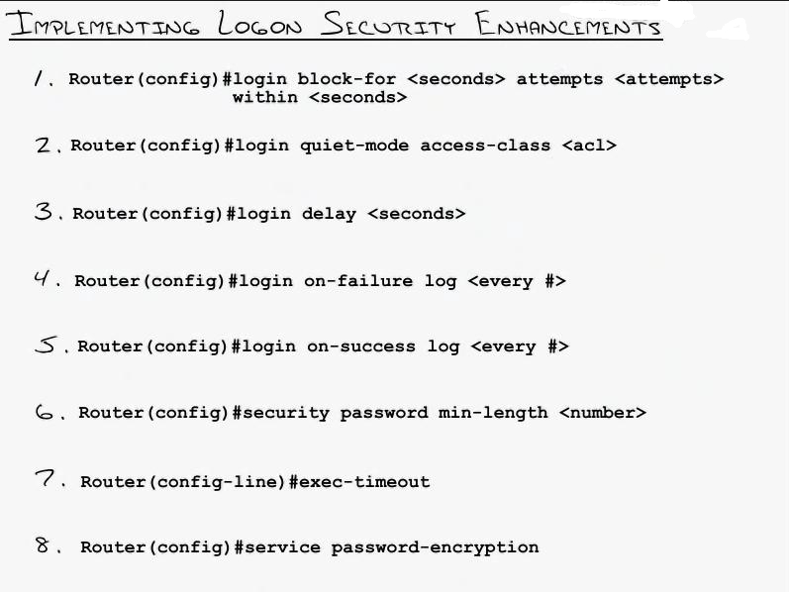
Enhanced Login Features
The following commands are available to configure a Cisco IOS device to support the enhanced login features:
Notes:
14

Slide 15
login block-for Command
All login enhancement features are disabled by default. The login block-for command enables configuration of the login enhancement features.
The login block-for feature monitors login device activity and operates in two modes:
Normal-Mode (Watch-Mode) —The router keeps count of the number of failed login attempts within an identified amount of time.
Quiet-Mode (Quiet Period) — If the number of failed logins exceeds the configured threshold, all login attempts made using Telnet, SSH, and HTTP are denied.
The quite mode is implemented by applying an access-list to the VTY lines. You can specify the access-list yourself with the login quiet-mode access-class { acl-name-or-number } command, otherwise the router generates an access-list named sl_def_acl ...
Extended IP access list sl_def_acl 10 deny tcp any any eq telnet log 20 deny tcp any any eq www log 30 deny tcp any any eq 22 log 40 permit tcp any any eq 22 log
and applies it with the access-class in command to the VTY lines.

Slide 16
System Logging Messages
To generate log messages for successful/failed logins:
login on-failure log
login on-success log
To generate a message when failure rate is exceeded:
security authentication failure rate threshold-rate log
To verify that the login block-for command is configured and which mode the router is currently in:
show login
To display more information regarding the failed attempts:
show login failures
Notes:
16

Slide 17
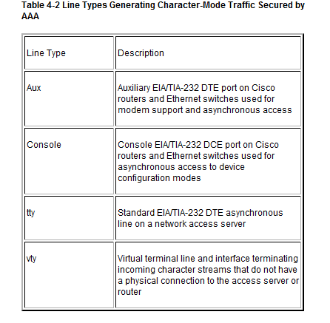
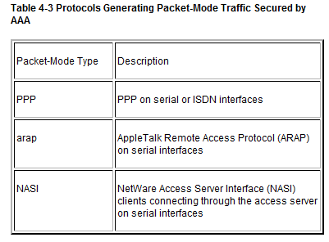
Access Methods
Character Mode
A user sends a request to establish an EXEC mode process with the router for administrative purposes
Packet Mode
A user sends a request to establish a connection through the router with a device on the network

Slide 18


Self-Contained AAA Authentication
Remote Client
AAA Router
1
2
3
Self-Contained AAA
The client establishes a connection with the router.
The AAA router prompts the user for a username and password.
The router authenticates the username and password using the local database and the user is authorized to access the network based on information in the local database.
Used for small networks
Stores usernames and passwords locally in the Cisco router

Slide 19
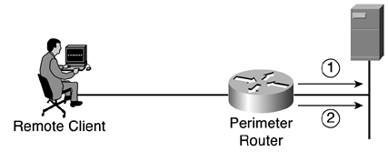
Server-Based AAA Authentication
Uses an external database server
Cisco Secure Access Control Server (ACS) for Windows Server
Cisco Secure ACS Solution Engine
Cisco Secure ACS Express
More appropriate if there are multiple routers
Remote Client
AAA Router
Cisco Secure ACS Server
1
2
3
4
Server-Based AAA
The client establishes a connection with the router.
The AAA router prompts the user for a username and password.
The router authenticates the username and password using a remote AAA server.
The user is authorized to access the network based on information on the remote AAA Server.

Slide 20
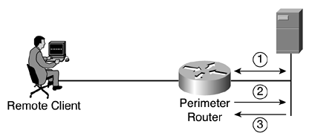
AAA Authorization
Typically implemented using an AAA server-based solution
Uses a set of attributes that describes user access to the network
When a user has been authenticated, a session is established with an AAA server.
The router requests authorization for the requested service from the AAA server.
The AAA server returns a PASS/FAIL for authorization.

Slide 21
AAA Accounting
Implemented using an AAA server-based solution
Keeps a detailed log of what an authenticated user does on a device
When a user has been authenticated, the AAA accounting process generates a start message to begin the accounting process.
When the user finishes, a stop message is recorded ending the accounting process.

Slide 22
Local AAA Authentication Commands
R1# conf t
R1(config)# username JR-ADMIN secret Str0ngPa55w0rd
R1(config)# username ADMIN secret Str0ng5rPa55w0rd
R1(config)# aaa new-model
R1(config)# aaa authentication login default local-case
R1(config)# aaa local authentication attempts max-fail 10
To authenticate administrator access (character mode access)
Add usernames and passwords to the local router database
Enable AAA globally
Configure AAA parameters on the router
Confirm and troubleshoot the AAA configuration

Slide 23
Additional Commands
aaa authentication enable
Enables AAA for EXEC mode access
aaa authentication ppp
Enables AAA for PPP network access

Slide 24
AAA Authentication Command Elements
router(config)#
aaa authentication login {default | list-name} method1…[method4]
Command | Description
default | Uses the listed authentication methods that follow this keyword as the default list of methods when a user logs in
list-name | Character string used to name the list of authentication methods activated when a user logs in
password-expiry | Enables password aging on a local authentication list.
method1 [method2...] | Identifies the list of methods that the authentication algorithm tries in the given sequence. You must enter at least one method; you may enter up to four methods.

Slide 25
Method Type Keywords
Keywords | Description
enable | Uses the enable password for authentication. This keyword cannot be used.
krb5 | Uses Kerberos 5 for authentication.
krb5-telnet | Uses Kerberos 5 telnet authentication protocol when using Telnet to connect to the router.
line | Uses the line password for authentication.
local | Uses the local username database for authentication.
local-case | Uses case-sensitive local username authentication.
none | Uses no authentication.
cache group-name | Uses a cache server group for authentication.
group radius | Uses the list of all RADIUS servers for authentication.
group tacacs+ | Uses the list of all TACACS+ servers for authentication.
group group-name | Uses a subset of RADIUS or TACACS+ servers for authentication as defined by the aaa group server radius or aaa group server tacacs+ command.

Slide 26
Additional Security
router(config)#
aaa local authentication attempts max-fail [number-of-unsuccessful-attempts]
R1# show aaa local user lockout
Local-user Lock time
JR-ADMIN 04:28:49 UTC Sat Dec 27 2008
clear aaa local user lockout {username username | all}
Unlocks a locked-out user
Example:
Router# clear aaa local user lockout username user1
R1# show aaa sessions
Total sessions since last reload: 4
Session Id: 1
Unique Id: 175
User Name: ADMIN
IP Address: 192.168.1.10
Idle Time: 0
CT Call Handle: 0

Slide 27
Sample Configuration
R1# conf t
R1(config)# username JR-ADMIN secret Str0ngPa55w0rd
R1(config)# username ADMIN secret Str0ng5rPa55w0rd
R1(config)# aaa new-model
R1(config)# aaa authentication login default local-case enable
R1(config)# aaa authentication login TELNET-LOGIN local-case
R1(config)# line vty 0 4
R1(config-line)# login authentication TELNET-LOGIN

Slide 28
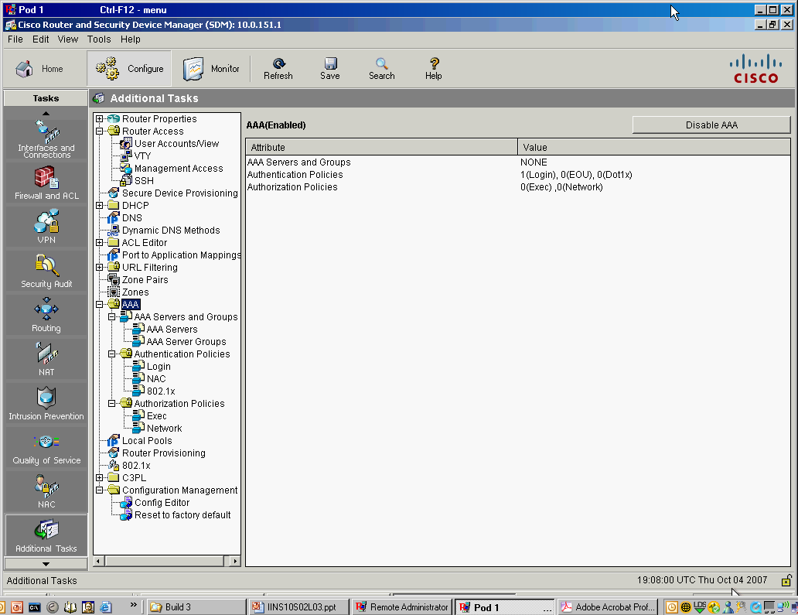
Verifying AAA Authentication
AAA is enabled by default in SDM
To verify or enable/disable AAA, choose Configure > Additional Tasks > AAA

Slide 29
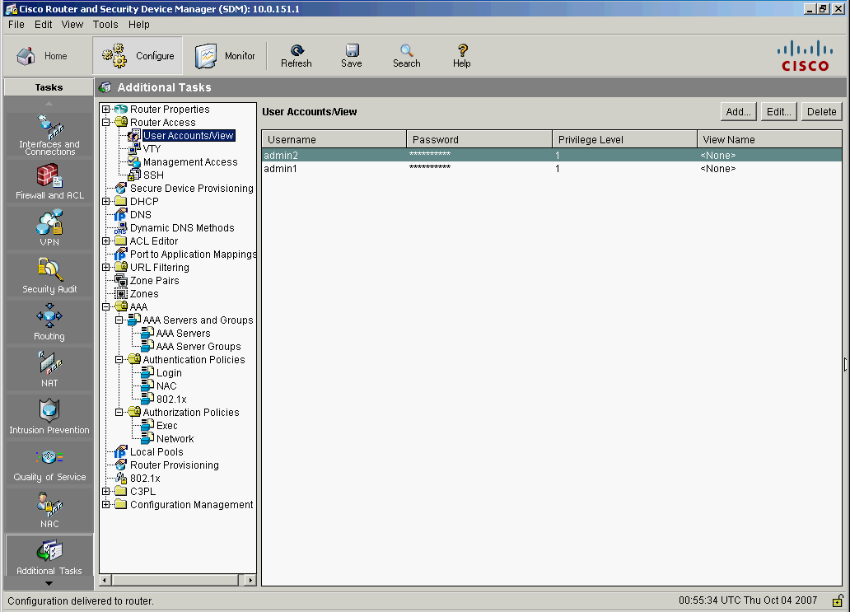
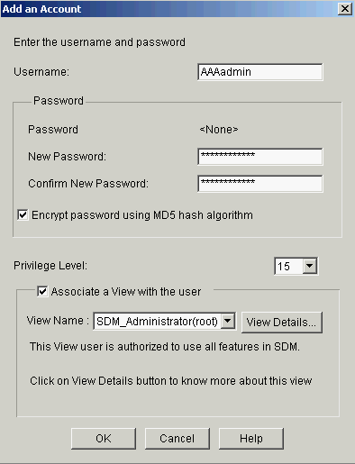
Using SDM
Select Configure > Additional Tasks > Router Access > User Accounts/View
2. Click Add
3. Enter username and password
4. Choose 15
5. Check the box and select a view
6. Click OK

Slide 30
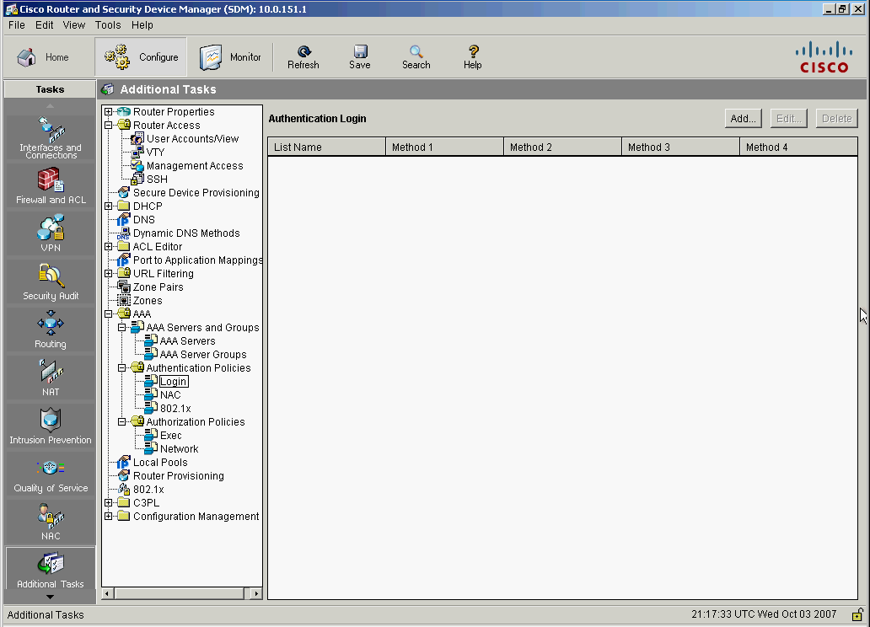
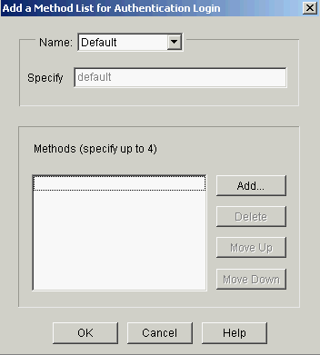
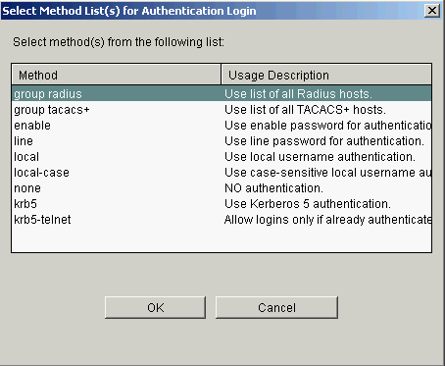
Configure Login Authentication
1. Select Configure > Additional Tasks > AAA > Authentication Policies > Login and click Add
2. Verify that Default is selected
3. Click Add
4. Choose local
5. Click OK
6. Click OK

Slide 31
Troubleshooting
The debug aaa Command
Sample Output

Slide 32
The debug aaa Command
R1# debug aaa ?
accounting Accounting
administrative Administrative
api AAA api events
attr AAA Attr Manager
authentication Authentication
authorization Authorization
cache Cache activities
coa AAA CoA processing
db AAA DB Manager
dead-criteria AAA Dead-Criteria Info
id AAA Unique Id
ipc AAA IPC
mlist-ref-count Method list reference counts
mlist-state Information about AAA method list state change and
notification
per-user Per-user attributes
pod AAA POD processing
protocol AAA protocol processing
server-ref-count Server handle reference counts
sg-ref-count Server group handle reference counts
sg-server-selection Server Group Server Selection
subsys AAA Subsystem
testing Info. about AAA generated test packets
R1# debug aaa

Slide 33
Sample Output
R1# debug aaa authentication
113123: Feb 4 10:11:19.305 CST: AAA/MEMORY: create_user (0x619C4940) user=''
ruser='' port='tty1' rem_addr='async/81560' authen_type=ASCII service=LOGIN priv=1
113124: Feb 4 10:11:19.305 CST: AAA/AUTHEN/START (2784097690): port='tty1' list=''
action=LOGIN service=LOGIN
113125: Feb 4 10:11:19.305 CST: AAA/AUTHEN/START (2784097690): using "default" list
113126: Feb 4 10:11:19.305 CST: AAA/AUTHEN/START (2784097690): Method=LOCAL
113127: Feb 4 10:11:19.305 CST: AAA/AUTHEN (2784097690): status = GETUSER
113128: Feb 4 10:11:26.305 CST: AAA/AUTHEN/CONT (2784097690): continue_login
(user='(undef)')
113129: Feb 4 10:11:26.305 CST: AAA/AUTHEN (2784097690): status = GETUSER
113130: Feb 4 10:11:26.305 CST: AAA/AUTHEN/CONT (2784097690): Method=LOCAL
113131: Feb 4 10:11:26.305 CST: AAA/AUTHEN (2784097690): status = GETPASS
113132: Feb 4 10:11:28.145 CST: AAA/AUTHEN/CONT (2784097690): continue_login
(user='diallocal')
113133: Feb 4 10:11:28.145 CST: AAA/AUTHEN (2784097690): status = GETPASS
113134: Feb 4 10:11:28.145 CST: AAA/AUTHEN/CONT (2784097690): Method=LOCAL
113135: Feb 4 10:11:28.145 CST: AAA/AUTHEN (2784097690): status = PASS

Slide 34


Local Versus Server-Based Authentication
Local Authentication
The user establishes a connection with the router.
The router prompts the user for a username and password authenticating the user using a local database.
Cisco Secure ACS for Windows Server
Perimeter Router
1
3
2
4
Remote User
Server-Based Authentication
The user establishes a connection with the router.
The router prompts the user for a username and password.
The router passes the username and password to the Cisco Secure ACS (server or engine).
The Cisco Secure ACS authenticates the user. The user is authorized to access the router (administrative access) or the network based on information found in the Cisco Secure ACS database.

Slide 35
Overview of TACACS+ and RADIUS
TACACS+ or RADIUS protocols are used to communicate between the clients and AAA security servers.
Cisco Secure ACS for Windows Server
Perimeter Router
Remote User
Cisco Secure ACS Express

Slide 36
TACACS+/RADIUS Comparison
 | TACACS+ | RADIUS
Functionality | Separates AAA according to the AAA architecture, allowing modularity of the security server implementation | Combines authentication and authorization but separates accounting, allowing less flexibility in implementation than TACACS+.
Standard | Mostly Cisco supported | Open/RFC standard
Transport Protocol | TCP | UDP
CHAP | Bidirectional challenge and response as used in Challenge Handshake Authentication Protocol (CHAP) | Unidirectional challenge and response from the RADIUS security server to the RADIUS client.
Protocol Support | Multiprotocol support | No ARA, no NetBEUI
Confidentiality | Entire packet encrypted | Password encrypted
Customization | Provides authorization of router commands on a per-user or per-group basis. | Has no option to authorize router commands on a per-user or per-group basis
Confidentiality | Limited | Extensive

Slide 37
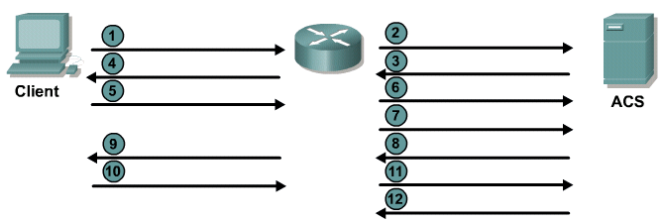
TACACS+ Authentication Process
Connect
Username prompt?
Username?
Use “Username”
JR-ADMIN
JR-ADMIN
Password prompt?
Password?
Use “Password”
“Str0ngPa55w0rd”
“Str0ngPa55w0rd”
Accept/Reject
Provides separate AAA services
Utilizes TCP port 49

Slide 38
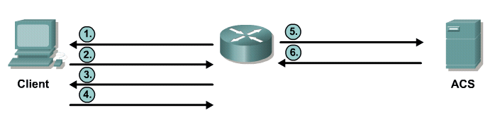
RADIUS Authentication Process
Access-Request
(JR_ADMIN, “Str0ngPa55w0rd”)
Username?
JR-ADMIN
Access-Accept
Password?
Str0ngPa55w0rd
Works in both local and roaming situations
Uses UDP ports 1645 or 1812 for authentication and UDP ports 1646 or 1813 for accounting

Slide 39
Cisco Secure ACS Benefits
Extends access security by combining authentication, user access, and administrator access with policy control
Allows greater flexibility and mobility, increased security, and user-productivity gains
Enforces a uniform security policy for all users
Reduces the administrative and management efforts

Slide 40
Advanced Features
Automatic service monitoring
Database synchronization and importing of tools for large-scale deployments
Lightweight Directory Access Protocol (LDAP) user authentication support
User and administrative access reporting
Restrictions to network access based on criteria
User and device group profiles

Slide 41

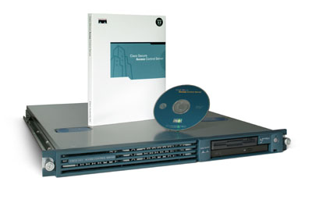
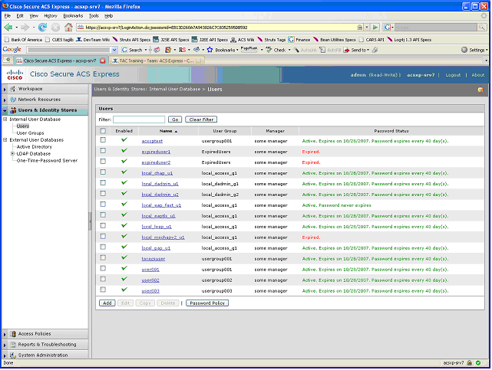
Installation Options
 | Cisco Secure ACS for Windows can be installed on: Windows 2000 Server with Service Pack 4 Windows 2000 Advanced Server with Service Pack 4 Windows Server 2003 Standard Edition Windows Server 2003 Enterprise Edition
 | Cisco Secure ACS Solution Engine A highly scalable dedicated platform that serves as a high-performance ACS 1RU, rack-mountable Preinstalled with a security-hardened Windows software, Cisco Secure ACS software Support for more than 350 users
 | Cisco Secure ACS Express 5.0 Entry-level ACS with simplified feature set Support for up to 50 AAA device and up to 350 unique user ID logins in a 24-hour period

Slide 42
Deploying ACS
Consider Third-Party Software Requirements
Verify Network and Port Prerequisites
AAA clients must run Cisco IOS Release 11.2 or later.
Cisco devices that are not Cisco IOS AAA clients must be configured with TACACS+, RADIUS, or both.
Dial-in, VPN, or wireless clients must be able to connect to AAA clients.
The computer running ACS must be able to reach all AAA clients using ping.
Gateway devices must permit communication over the ports that are needed to support the applicable feature or protocol.
A supported web browser must be installed on the computer running ACS.
All NICs in the computer running Cisco Secure ACS must be enabled.
Configure Secure ACS via the HTML interface

Slide 43
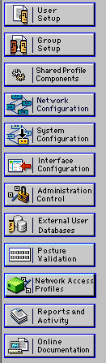
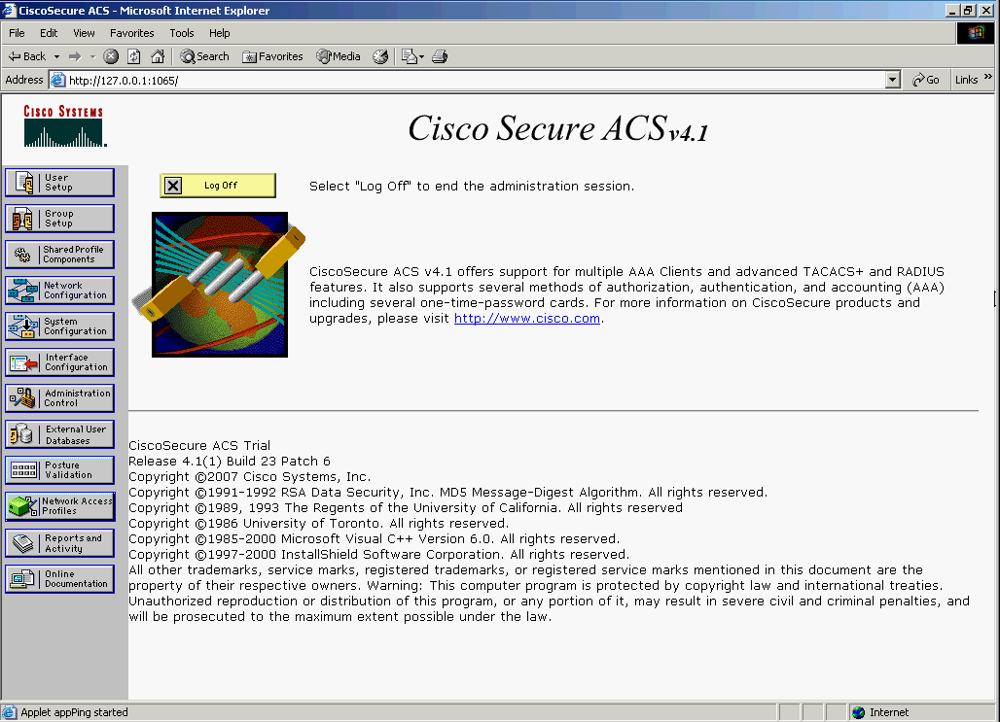
Cisco Secure ACS Homepage
add, delete, modify settings for AAA clients (routers)
set menu display options for TACACS and RADIUS
configure database settings

Slide 44
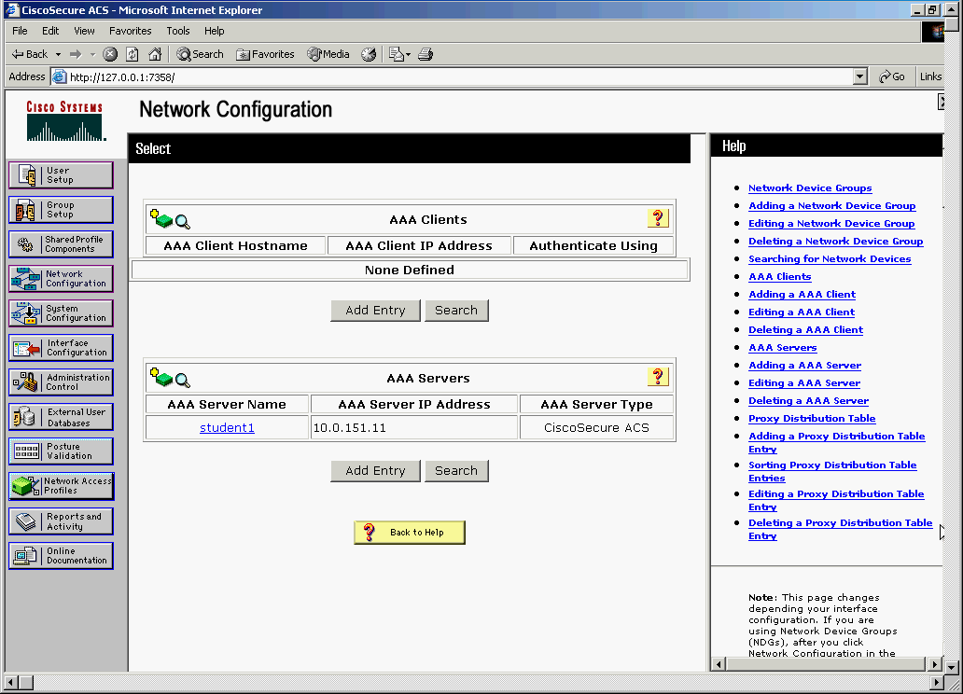
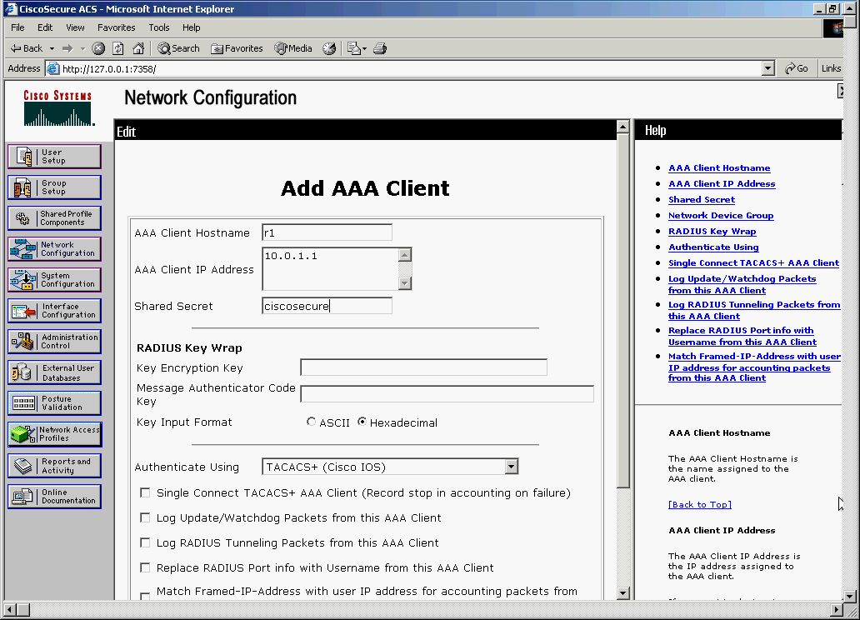
Network Configuration
1. Click Network Configuration on the navigation bar
2. Click Add Entry
3. Enter the hostname
4. Enter the IP address
5. Enter the secret key
6. Choose the appropriate
protocols
7. Make any other necessary
selections and click Submit
and Apply

Slide 45
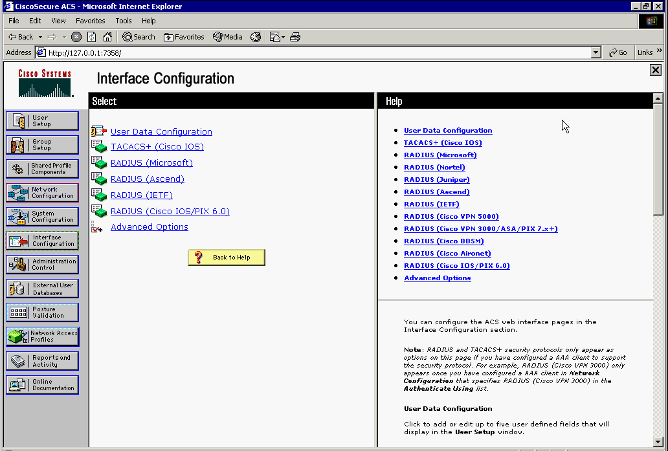
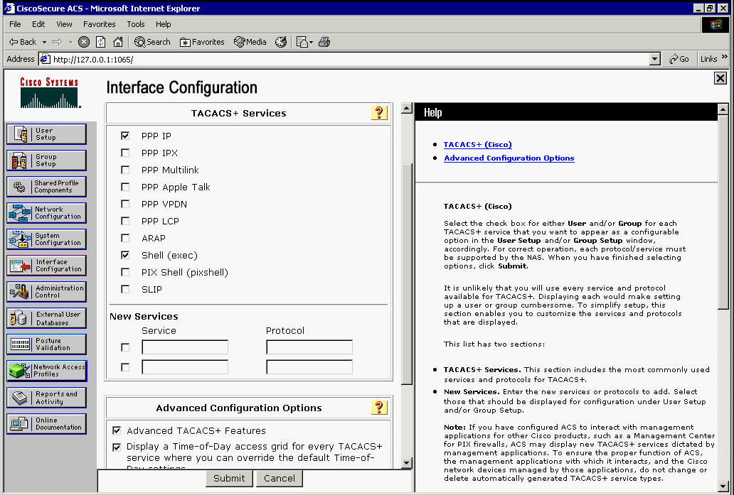
Interface Configuration
The selection made in the Interface Configuration window controls the display of options in the user interface

Slide 46
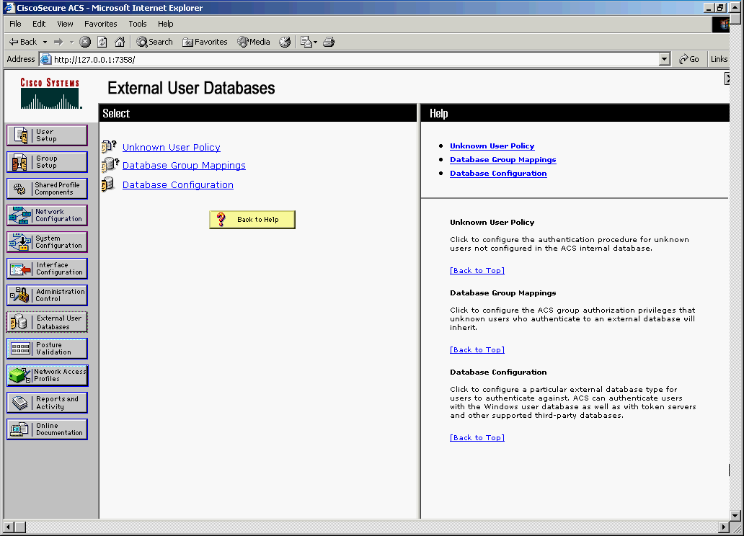
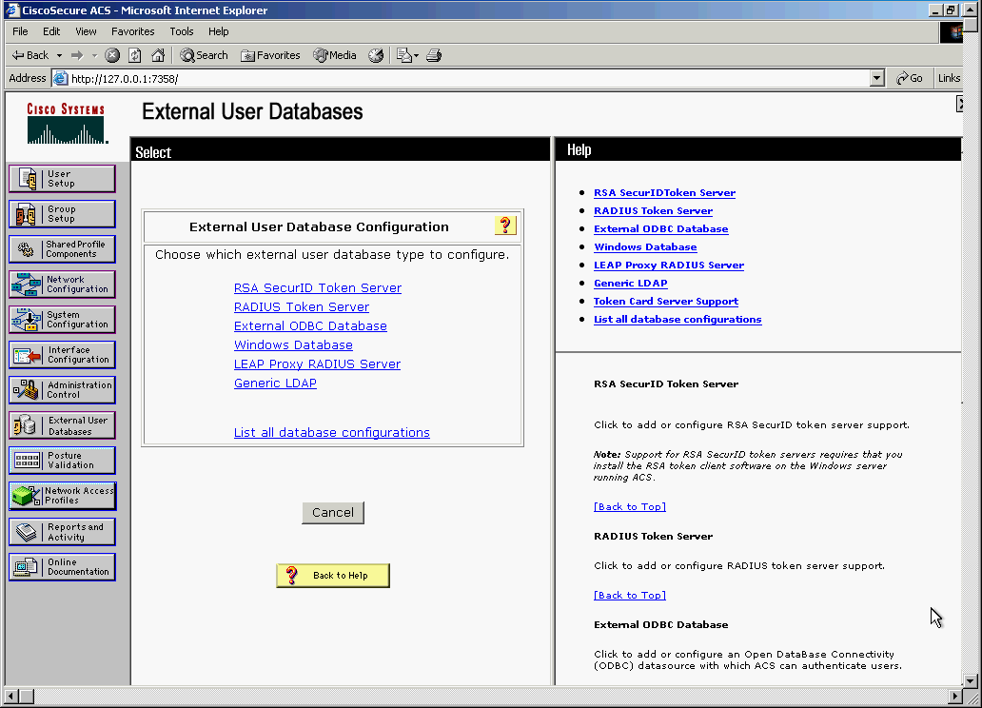
External User Database
1. Click the External User Databases button on the navigation bar
2. Click Database Configuration
3. Click Windows Database

Slide 47
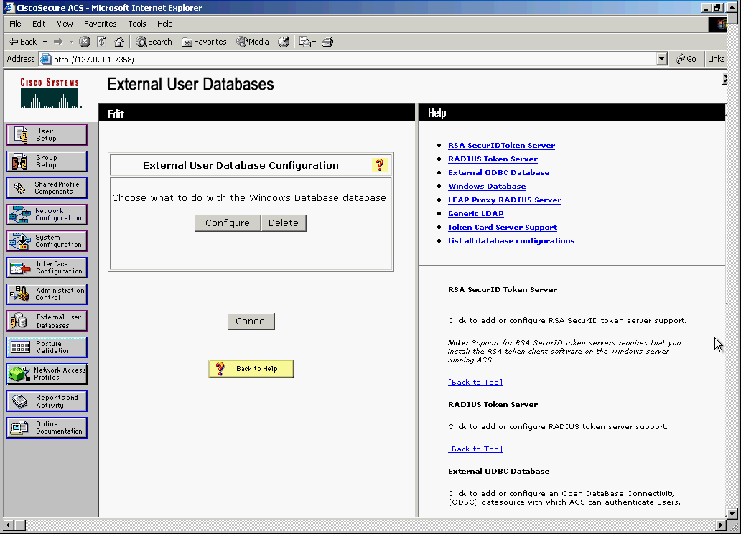
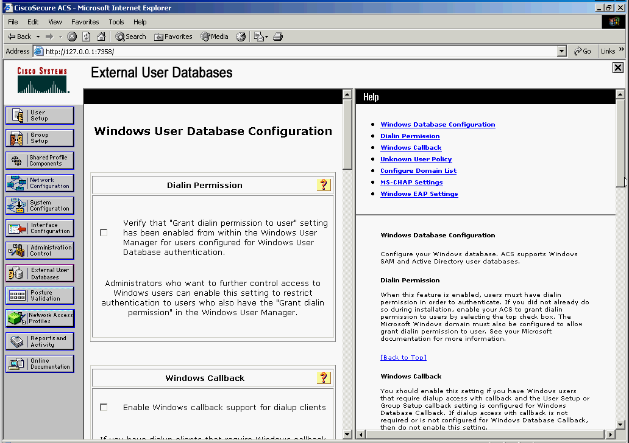
Windows User Database Configuration
4. Click configure
5. Configure options

Slide 48
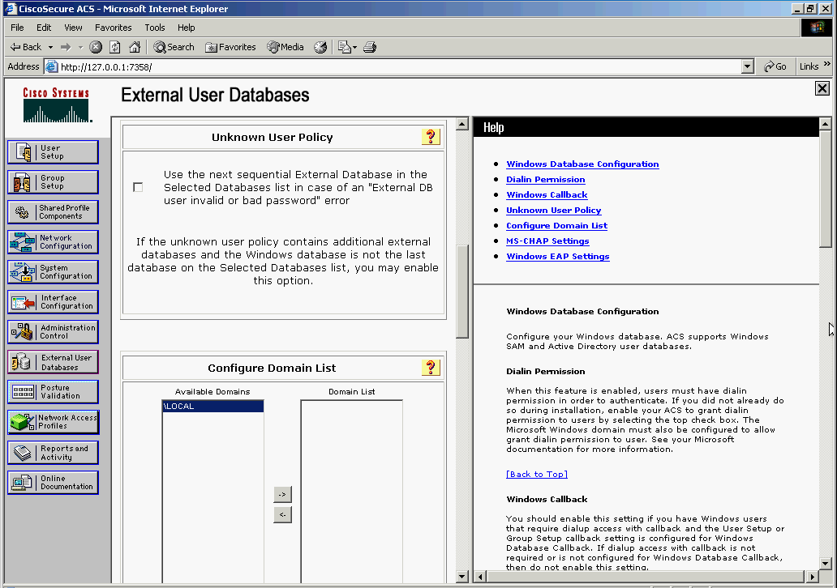
Configuring the Unknown User Policy
1. Click External User Databases on the navigation bar
2. Click Unknown User Policy
3. Place a check in the box
4. Choose the database in from the list and click the right arrow to move it to the Selected list
5. Manipulate the databases to reflect the order
in which each will be checked
6. Click Submit

Slide 49
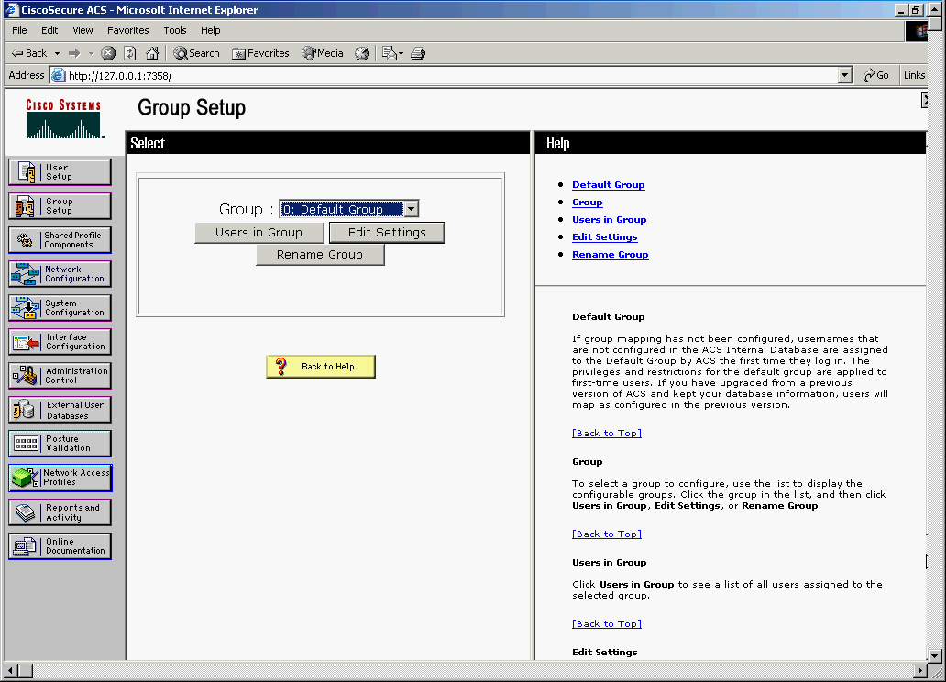
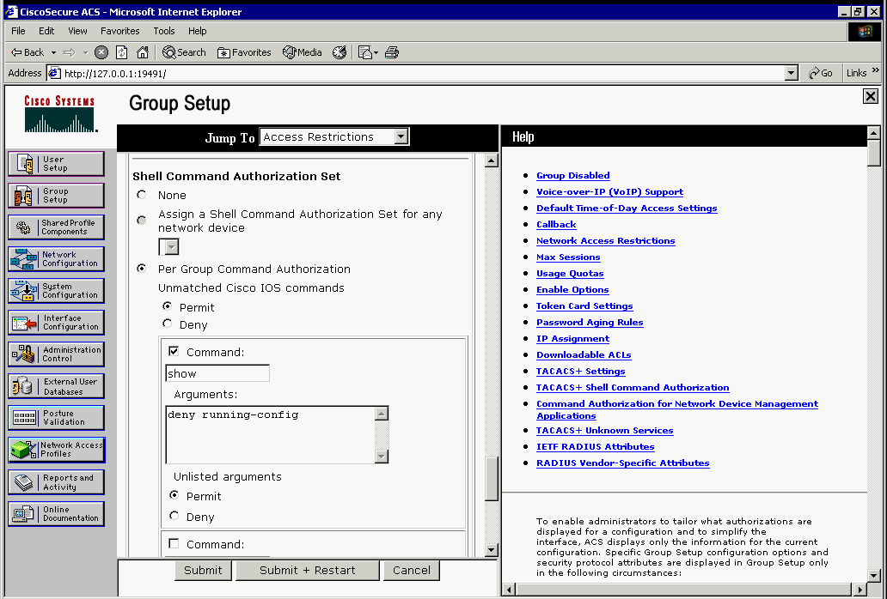
Group Setup
Database group mappings - Control authorizations for users authenticated by the Windows server in one group and those authenticated by the LDAP server in another
1. Click Group Setup on the navigation bar
2. Choose the group to edit and click
Edit Settings
3. Click Permit in the Unmatched
Cisco IOS commands option
4. Check the Command check box and select an argument
5. For the Unlisted Arguments option,
click Permit

Slide 50
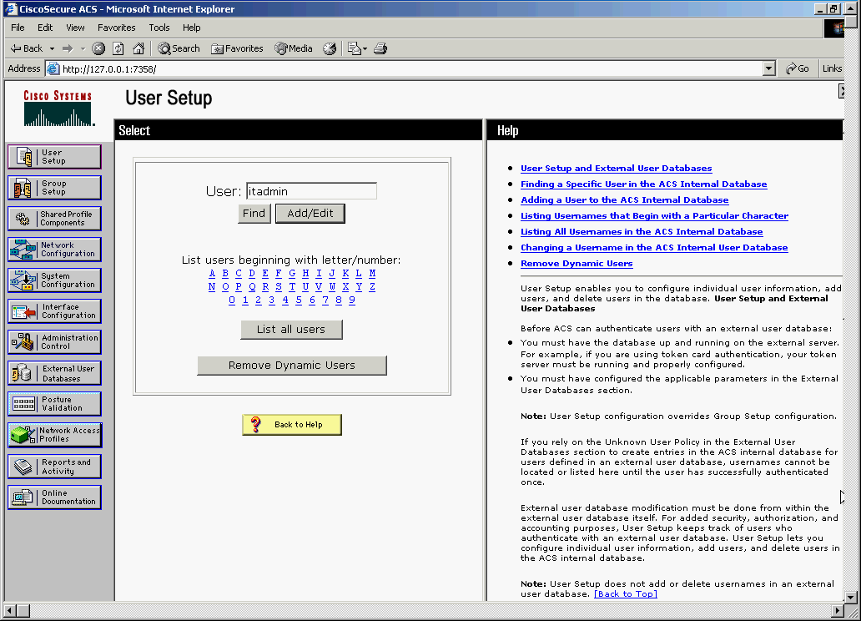
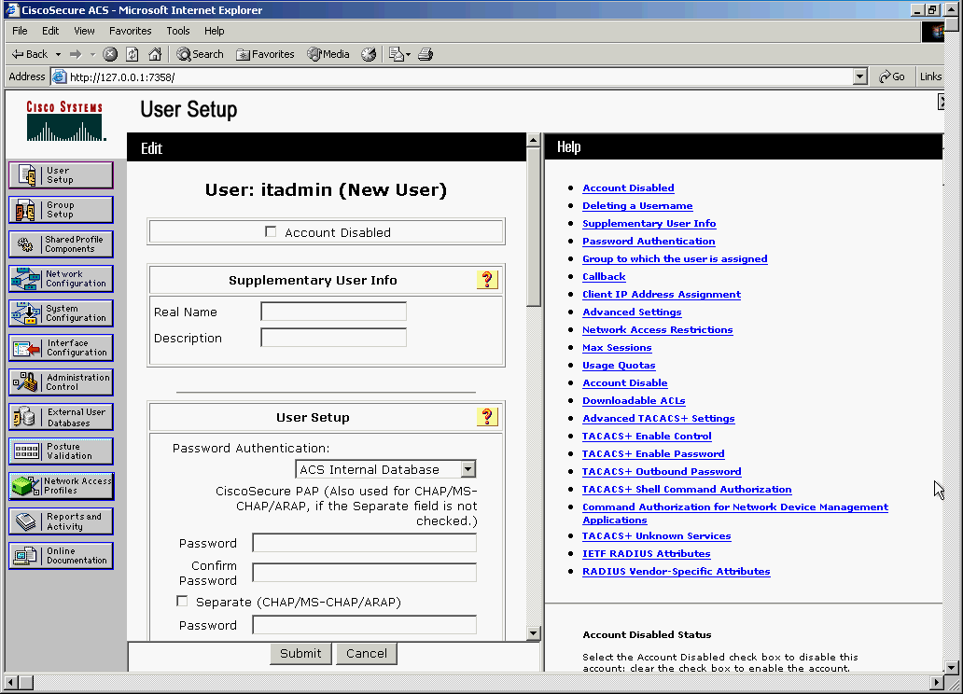
User Setup
1. Click User Setup on the navigation bar
2. Enter a username and click Add/Edit
3. Enter the data to define the user account
4. Click Submit
Notes:
If there are user properties that you do not see, you may have to modify the interface configuration. Choose Interface Configuration > User Data Configuration to modify the user interface.

Slide 51
Configuring Server-Based AAA Authentication
Globally enable AAA to allow the user of all AAA elements (a prerequisite)
Specify the Cisco Secure ACS that will provide AAA services for the network access server
Configure the encryption key that will be used to encrypt the data transfer between the network access server and the Cisco Secure ACS
Configure the AAA authentication method list

Slide 52
aaa authentication Command
R1(config)# aaa authentication type { default | list-name } method1 … [method4]
R1(config)# aaa authentication login default ?
enable Use enable password for authentication.
group Use Server-group
krb5 Use Kerberos 5 authentication.
krb5-telnet Allow logins only if already authenticated via Kerberos V
Telnet.
line Use line password for authentication.
local Use local username authentication.
local-case Use case-sensitive local username authentication.
none NO authentication.
passwd-expiry enable the login list to provide password aging support
R1(config)# aaa authentication login default group ?
WORD Server-group name
radius Use list of all Radius hosts.
tacacs+ Use list of all Tacacs+ hosts.
R1(config)# aaa authentication login default group

Slide 53
Sample Configuration
Multiple RADIUS servers can be identified by entering a radius-server command for each
For TACACS+, the single-connection command maintains a single TCP connection for the life of the session
TACACS+ or RADIUS protocols are used to communicate between the clients and AAA security servers.
192.168.1.100
R1
Cisco Secure ACS for Windows
using RADIUS
R1(config)# aaa new-model
R1(config)#
R1(config)# radius-server host 192.168.1.100
R1(config)# radius-server key RADIUS-Pa55w0rd
R1(config)#
R1(config)# tacacs-server host 192.168.1.101
R1(config)# tacacs-server key TACACS+Pa55w0rd single-connection
R1(config)#
R1(config)# aaa authentication login default group tacacs+ group radius local-case
R1(config)#
192.168.1.101
Cisco Secure ACS Solution Engine
using TACACS+

Slide 54
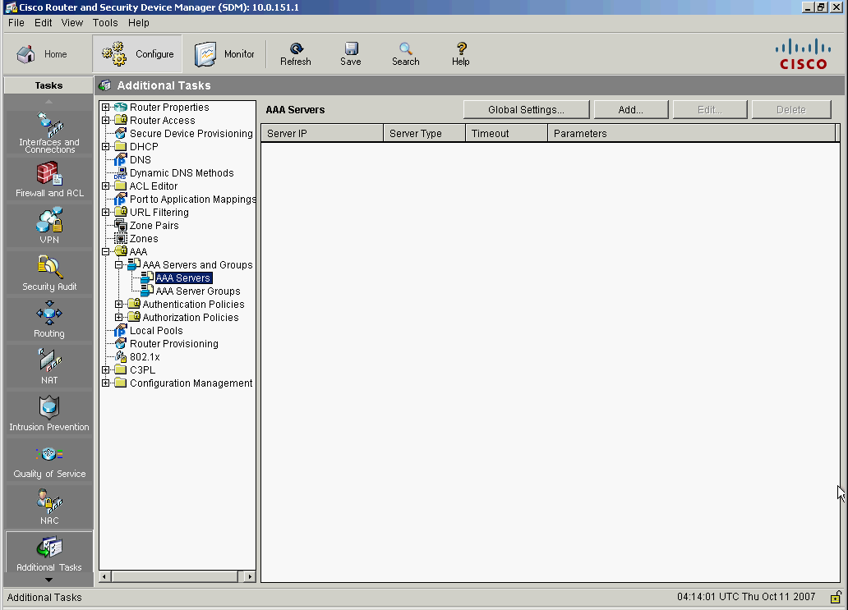
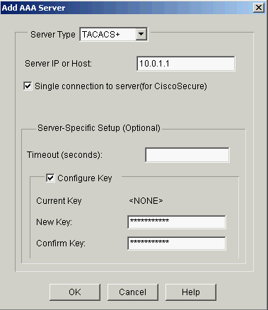
Add TACACS Support
1. Choose Configure > Additional Tasks > AAA > AAA Servers and Groups > AAA Servers
2. Click Add
3. Choose TACACS+
192.168.1.101
4. Enter the IP address (or hostname) of the AAA server
5. Check the Single Connection check box to maintain a single connection
6. Check the Configure Key to encrypt traffic
7. Click OK

Slide 55
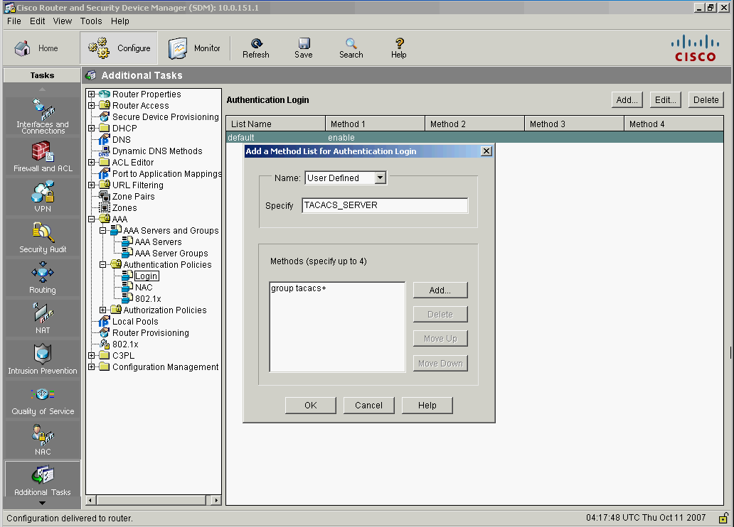
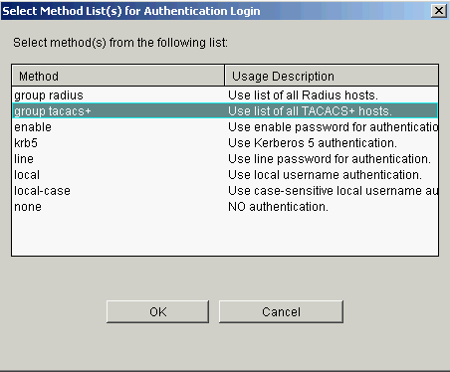
Create AAA Login Method
1. Choose Configure>Additional Tasks>AAA>Authentication Policies>Login
2. Click Add
3. Choose User Defined
4. Enter the name
5. Click Add
6. Choose group tacacs+ from the list
7. Click OK
8. Click Add to add a backup method
9. Choose enable from the list Click OK twice

Slide 56
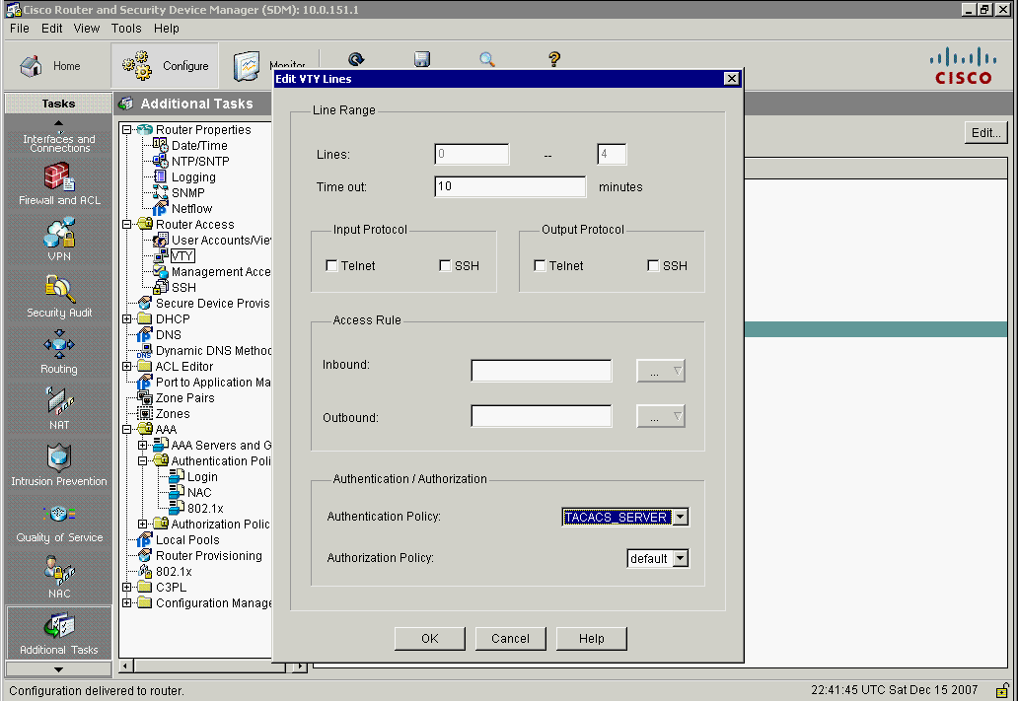
Apply Authentication Policy
1. Choose Configure>Additional Tasks>Router Access>VTY
2. Click Edit
3. Choose the authentication
policy to apply

Slide 57
Sample Commands
R1# debug aaa authentication
AAA Authentication debugging is on
R1#
14:01:17: AAA/AUTHEN (567936829): Method=TACACS+
14:01:17: TAC+: send AUTHEN/CONT packet
14:01:17: TAC+ (567936829): received authen response status = PASS
14:01:17: AAA/AUTHEN (567936829): status = PASS
The debug aaa authentication command provides a view of login activity
For successful TACACS+ login attempts, a status message of PASS results

Slide 58
Sample Commands
R1# debug radius ?
accounting RADIUS accounting packets only
authentication RADIUS authentication packets only
brief Only I/O transactions are recorded
elog RADIUS event logging
failover Packets sent upon fail-over
local-server Local RADIUS server
retransmit Retransmission of packets
verbose Include non essential RADIUS debugs
<cr>
R1# debug radius
R1# debug tacacs ?
accounting TACACS+ protocol accounting
authentication TACACS+ protocol authentication
authorization TACACS+ protocol authorization
events TACACS+ protocol events
packet TACACS+ packets
<cr>

Slide 59
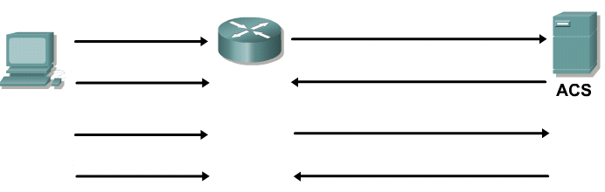
AAA Authorization Overview
Command authorization for user
JR-ADMIN, command “show version”?
show version
Display “show version” output
Accept
Command authorization for user
JR-ADMIN, command “config terminal”?
configure terminal
Do not permit “configure terminal”
Reject
The TACACS+ protocol allows the separation of authentication from authorization.
Can be configured to restrict the user to performing only certain functions after successful authentication.
Authorization can be configured for
character mode (exec authorization)
packet mode (network authorization)
RADIUS does not separate the authentication from the authorization process

Slide 60
AAA Authorization Commands
R1# conf t
R1(config)# username JR-ADMIN secret Str0ngPa55w0rd
R1(config)# username ADMIN secret Str0ng5rPa55w0rd
R1(config)# aaa new-model
R1(config)# aaa authentication login default group tacacs+
R1(config)# aaa authentication login TELNET-LOGIN local-case
R1(config)# aaa authorization exec default group tacacs+
R1(config)# aaa authorization network default group tacacs+
R1(config)# line vty 0 4
R1(config-line)# login authentication TELNET-LOGIN
R1(config-line)# ^Z
To configure command authorization, use:
aaa authorization service-type {default | list-name} method1 [method2] [method3] [method4]
Service types of interest include:
commands level For exec (shell) commands
exec For starting an exec (shell)
network For network services. (PPP, SLIP, ARAP)

Slide 61
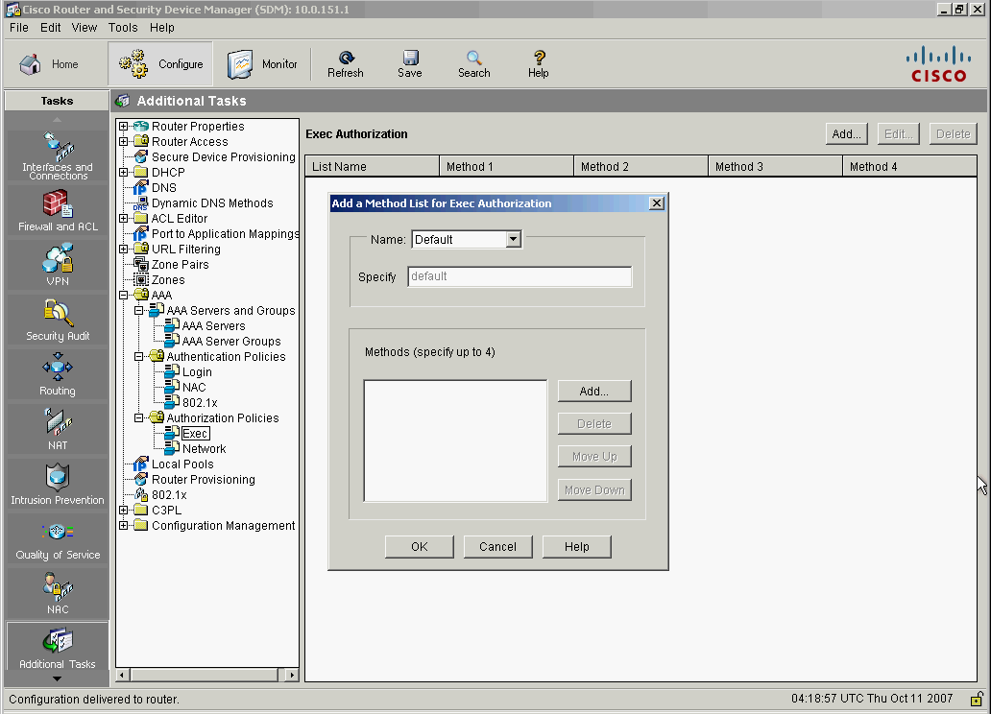
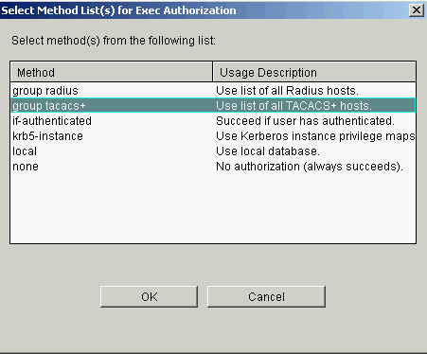
Using SDM to Configure Authorization Character Mode
1. Choose Configure>Additional Tasks>AAA>Authorization Policies>Exec
2. Click Add
3. Choose Default
4. Click Add
5. Choose group tacacs+ from the list
6. Click OK
7. Click OK to return to the Exec Authorization window

Slide 62
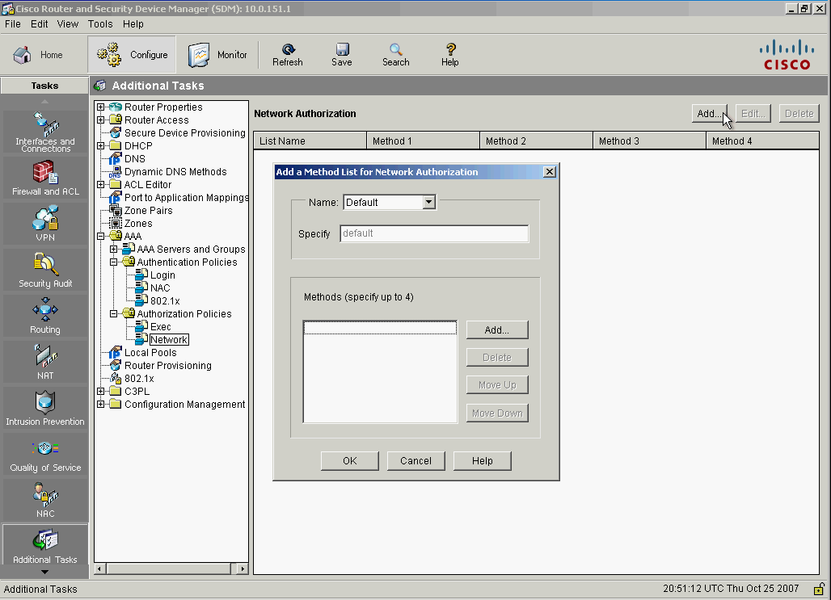
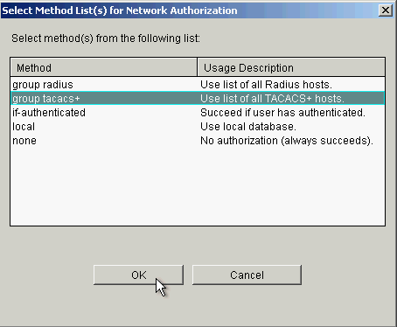
Using SDM to Configure Authorization Packet Mode
1. Choose Configure>Additional Tasks>AAA>Authorization Policies>Network
2. Click Add
3. Choose Default
4. Click Add
7. Click OK to return to
the Exec Authorization
pane
5. Choose group tacacs+ from the list
6. Click OK

Slide 63
AAA Accounting Overview
Provides the ability to track usage, such as dial-in access; the ability to log the data gathered to a database; and the ability to produce reports on the data gathered
To configure AAA accounting using named method lists:
aaa accounting {system | network | exec | connection | commands level} {default | list-name} {start-stop | wait-start | stop-only | none} [method1 [method2]]
Supports six different types of accounting: network, connection, exec, system, commands level, and resource.

Slide 64
AAA Accounting Commands
R1# conf t
R1(config)# username JR-ADMIN secret Str0ngPa55w0rd
R1(config)# username ADMIN secret Str0ng5rPa55w0rd
R1(config)# aaa new-model
R1(config)# aaa authentication login default group tacacs+
R1(config)# aaa authentication login TELNET-LOGIN local-case
R1(config)# aaa authorization exec group tacacs+
R1(config)# aaa authorization network group tacacs+
R1(config)# aaa accounting exec start-stop group tacacs+
R1(config)# aaa accounting network start-stop group tacacs+
R1(config)# line vty 0 4
R1(config-line)# login authentication TELNET-LOGIN
R1(config-line)# ^Z
aaa accounting exec default start-stop group tacacs+ Defines a AAA accounting policy that uses TACACS+ for logging both start and stop records for user EXEC terminal sessions.
aaa accounting network default start-stop group tacacs+ Defines a AAA accounting policy that uses TACACS+ for logging both start and stop records for all network-related service requests.

Slide 65


